Slide 1
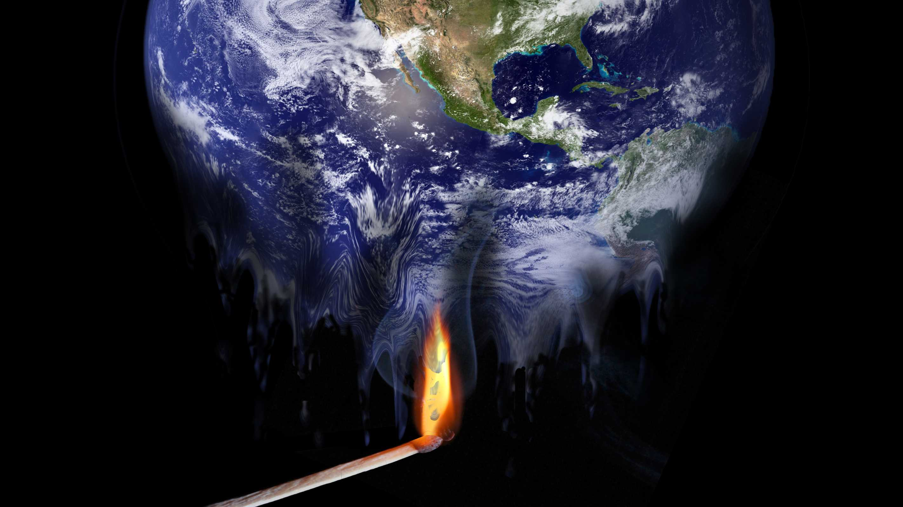


CLIMATE CHANGE
KONGU ENGINEERING COLLEGE PERUNDURAI
----- eraja ganapathy m
----- dhanush s

Slide 2

SYNOPSIS
CLIMATE CHANGE
CHANGE IS PROVOKED BY
NOTABLE CLIMATE EVENTS IN EARTH HISTORY
CLIMATE CHANGE CAUSES
VITAL SIGNS
FUTURE EVENTS
HOW TO EFFECT CHANGE

Slide 3

WHAT IS CLIMATE CHANGE
Climate change is a change in the statistical distribution of weather patterns when that change lasts for an extended period of time .
The term "climate change" is often used to refer specifically to anthropogenic climate change (also known as global warming). Anthropogenic climate change is caused by human activity, as opposed to changes in climate that may have resulted as part of Earth's natural processes.

Slide 4
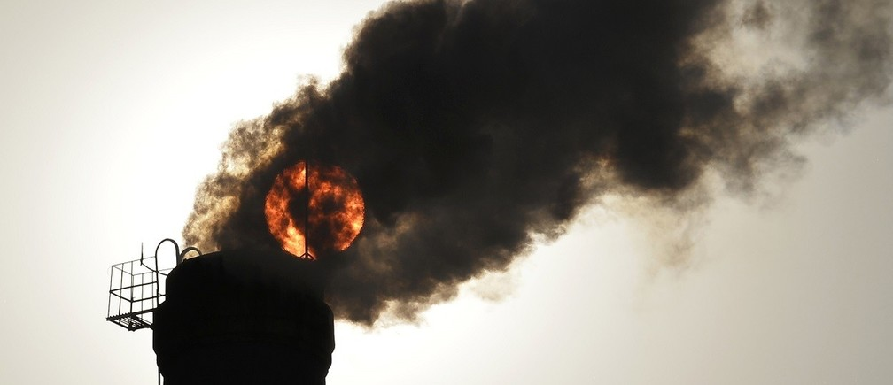
CLIMATE CHANGE IS PROVOKED BY
Internal forcing mechanisms
Ocean-atmosphere variability
Life
External forcing mechanisms
Human influences
variations
Solar output
Volcanism
Plate tectonics
Other mechanisms

Slide 5
NOTABLE CLIMATE EVENTS IN EARTH HISTORY
Younger Dryas/The Big Freeze (~11,000 BC)
Holocene climatic optimum (~7000–3000 BC)
Extreme weather events of 535–536 (535–536 AD)
Medieval Warm Period (900–1300)
Little Ice Age (1300–1800)
Year Without a Summer (1816)

Slide 6
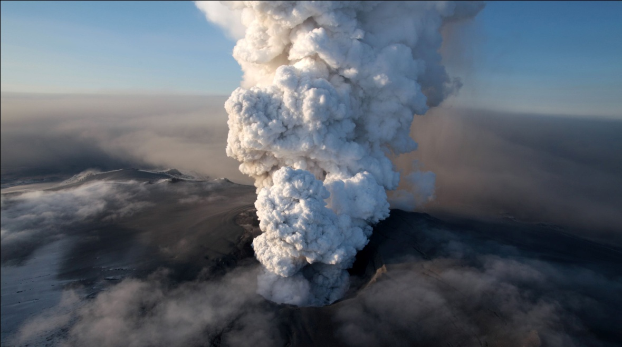
CLIMATE CHANGE CAUSES
Rising temperatures
Declining air quality
Extreme weather
Vector-borne illnesses
Species evolution

Slide 7
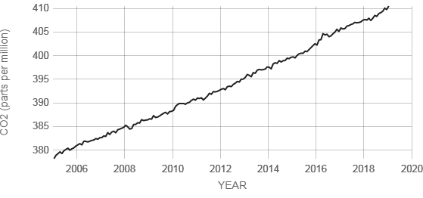
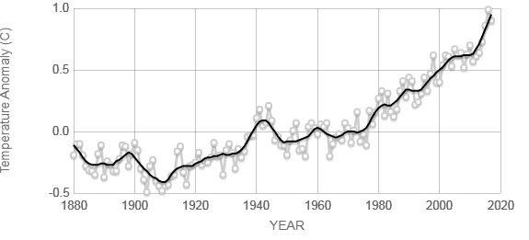
VITAL SIGNS
Carbon dioxide
Global temperature

Slide 8
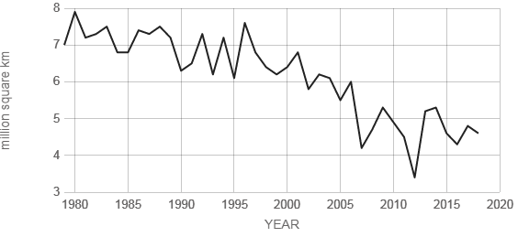
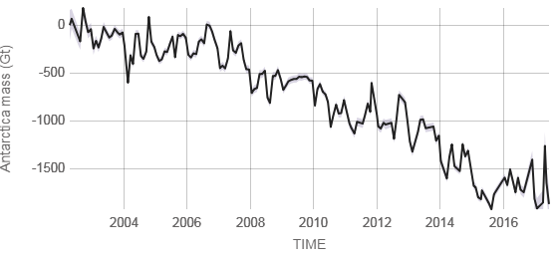
=
Arctic sea ice minimum
Ice sheets
Antarctica mass variation since 2002
RATE OF CHANGE
12.8
percent per decade
RATE OF CHANGE
127.0
Giga tonnes per year
margin: ±39

Slide 9
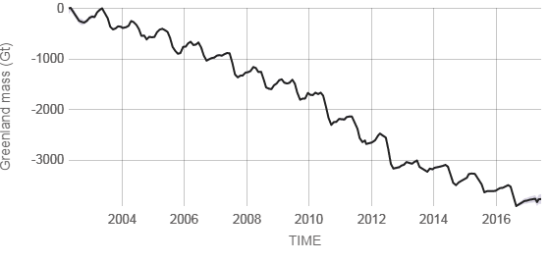
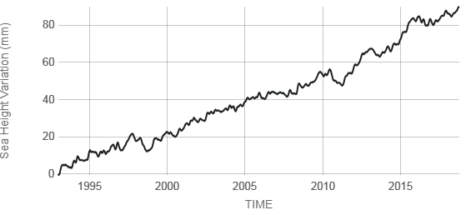
Greenland mass variation since 2002
RATE OF CHANGE
286.0
Gigatonnes per year
margin: ±21
Sea level
RATE OF CHANGE
3.2
millimeters per year

Slide 10
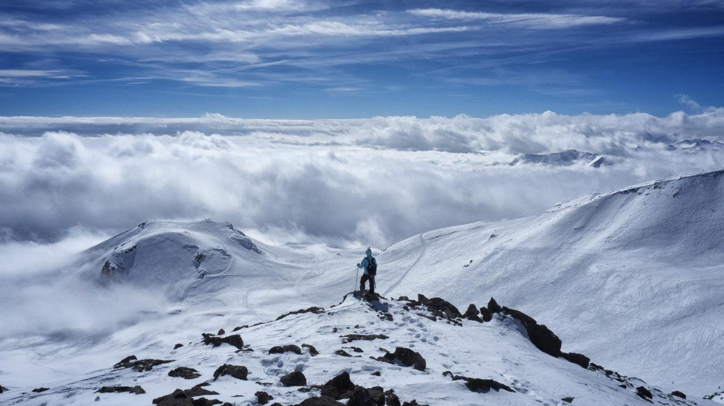
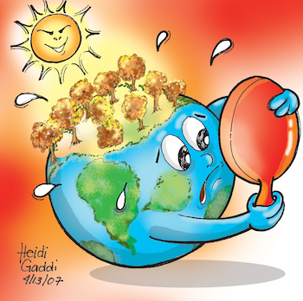
FUTURE EFFECTS
Temperatures will continue to rise
Frost-free season (and growing season) will lengthen
Changes in precipitation patterns
More droughts and heat waves
Hurricanes will become stronger and more intense
Sea level will rise 1-4 feet by 2100
Arctic likely to become ice-free

Slide 11
HOW TO EFFECT CHANGE
Driving more fuel-efficient cars or hybrid vehicles
Using public transportation or cycling to work
Using household appliances and devices that expend less energy
Retrofitting their homes with ‘green’ technologies (like solar panels or compact fluorescent light bulbs)
Researching alternative energies and getting involved in community-level projects that promote awareness of climate change causes and effects

Slide 12

CHANGE OF GLOBAL TEMPERATURE FROM 1884 -- 2017

Slide 13
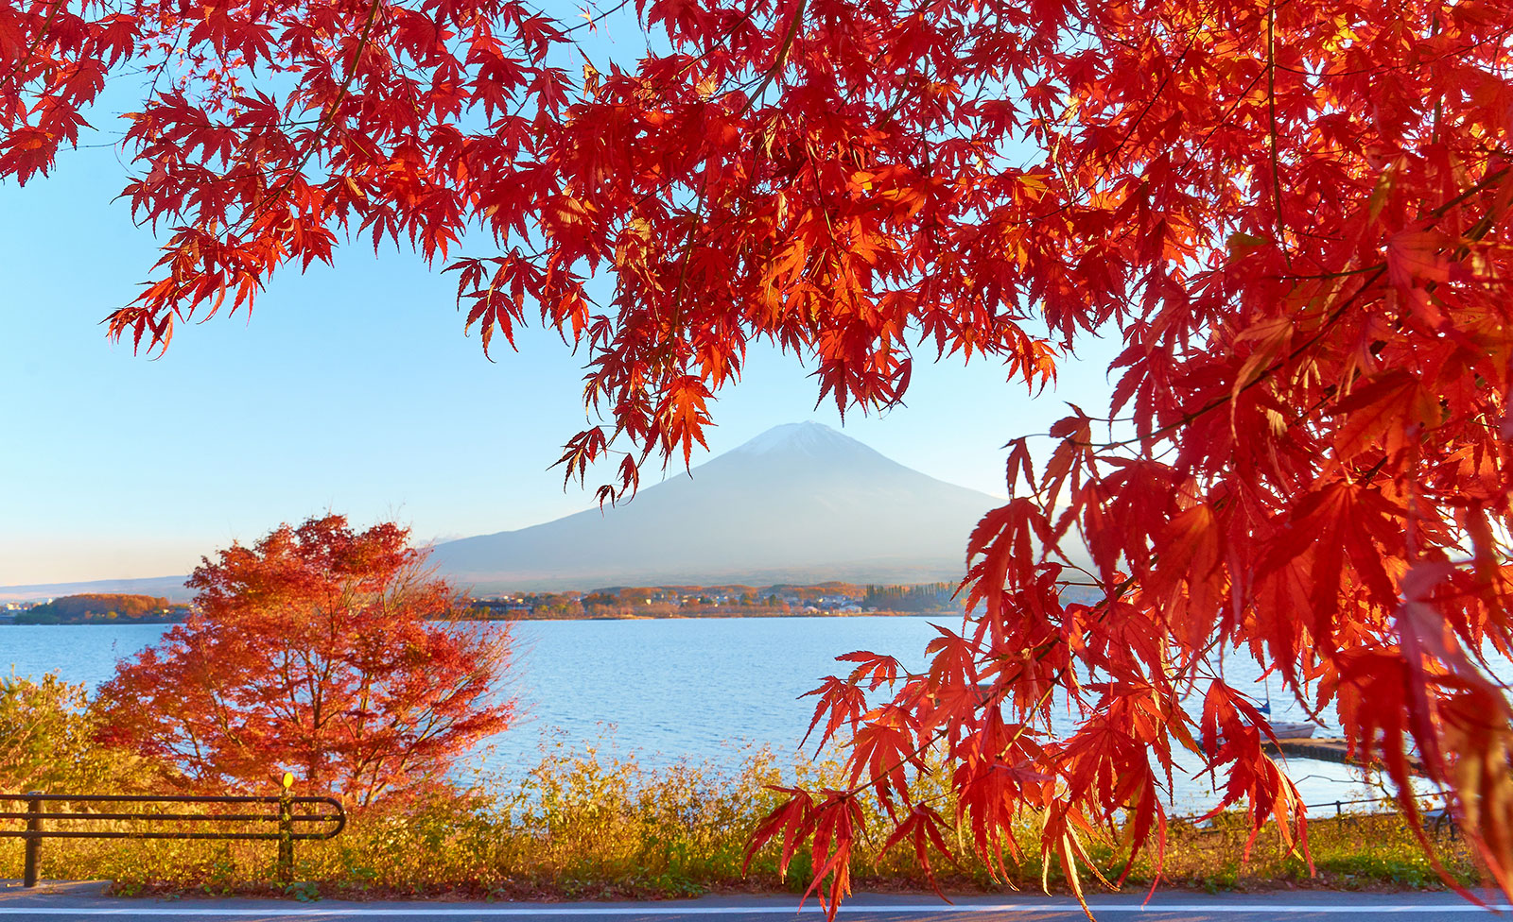
Thank you

